Slide 1
Project Presentation
Title- Home Bakery Shop
by : Manohar R
[110879]

Slide 2
Content
Problem statement
Technologies used
Technologies learnt
Architecture of application
Task performed

Slide 3
Problem statement
To create an ecommerce website on online cake shop which has various functionalities such as
Login page
Sign Up Page
Home Page
Customer Update Page
Product Page
Product Details Page
Cart Page
Order Confirm Page
Admin Login Page
All Order Details

Slide 4




Technologies Used

Slide 5
Technologies Learned
Database
Data structure
MySQL
Java Core
JSP
Junit
JQuery
Maven
Git
Spring and Spring boot
Rest Services

Slide 6
Architecture Diagram
.
Client Browser
Application
Server
Database
Eclipse IDE
Client
Server

Slide 7
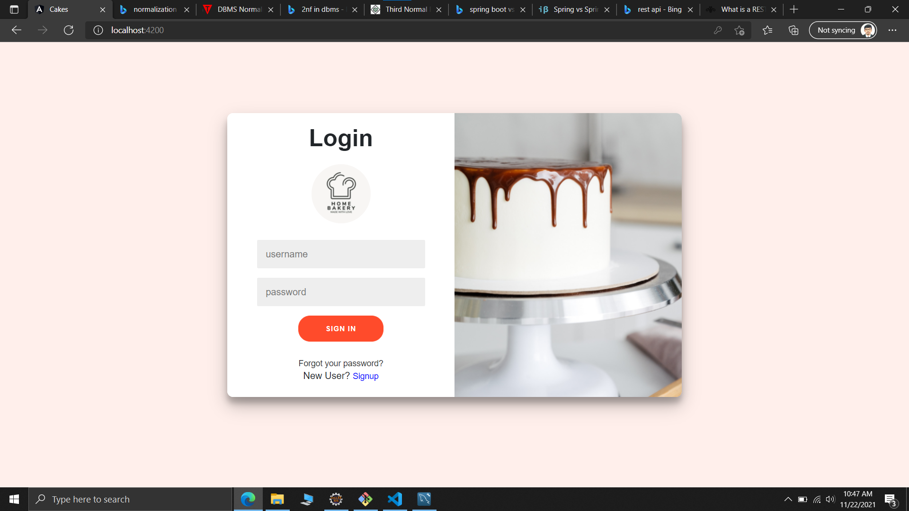
Login Page

Slide 8
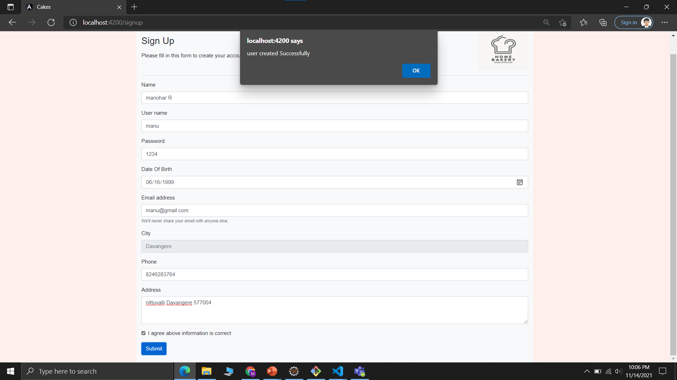
Sign Up Page

Slide 9
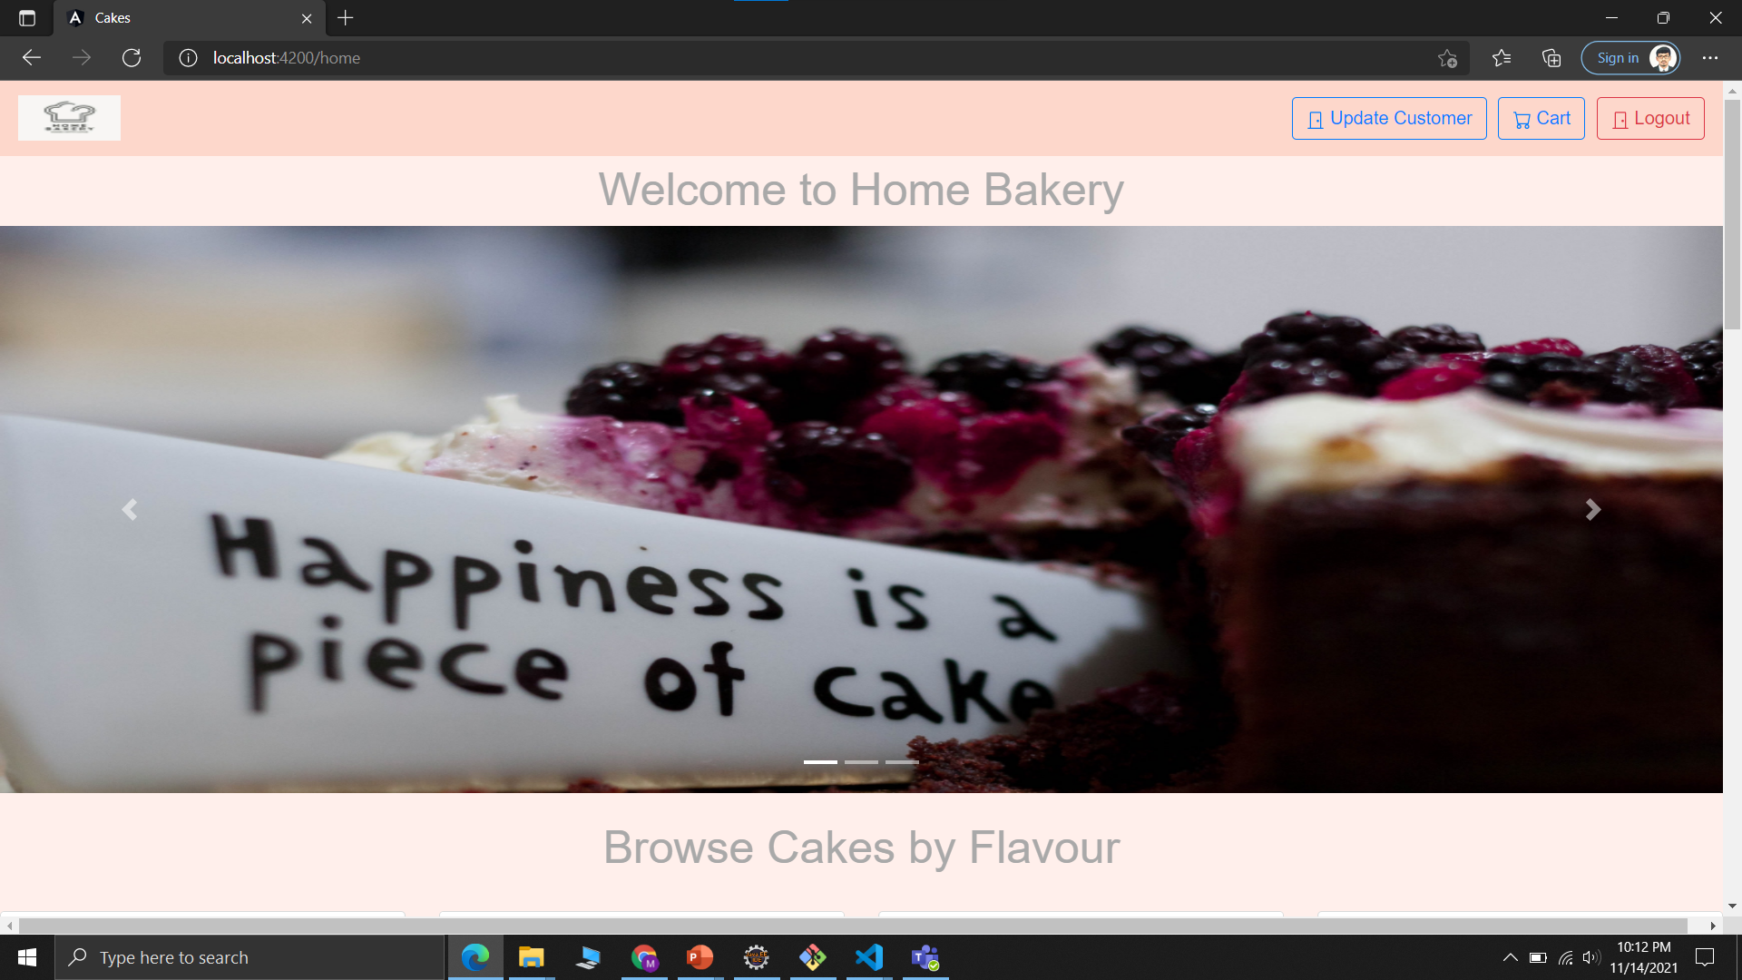
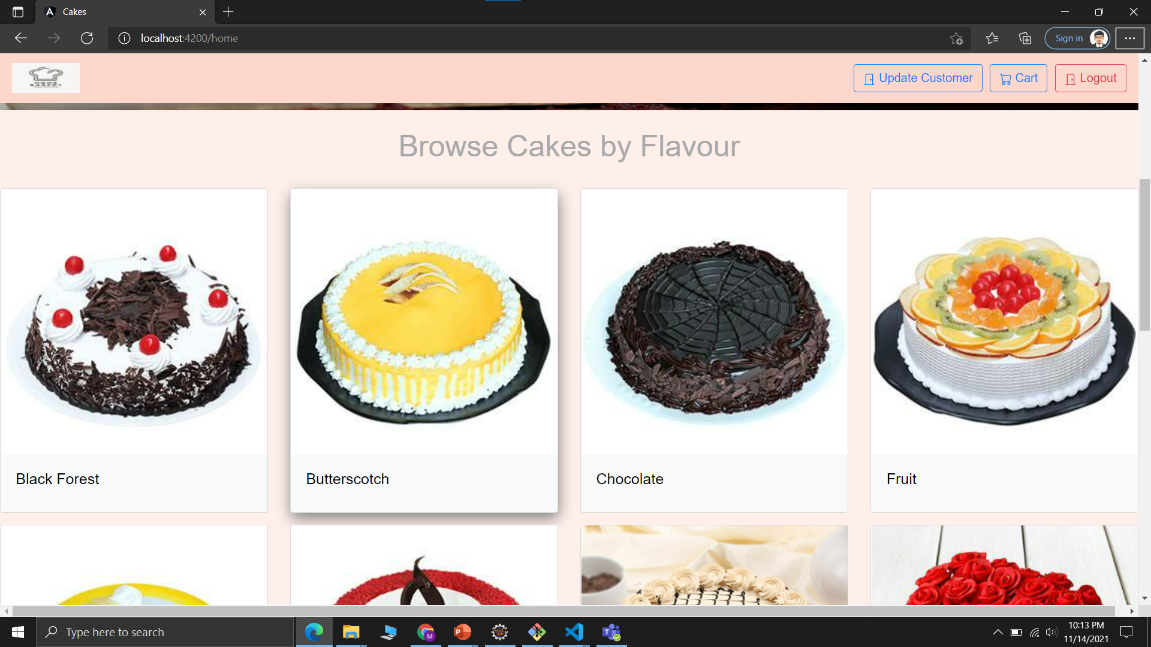
Home Page

Slide 10
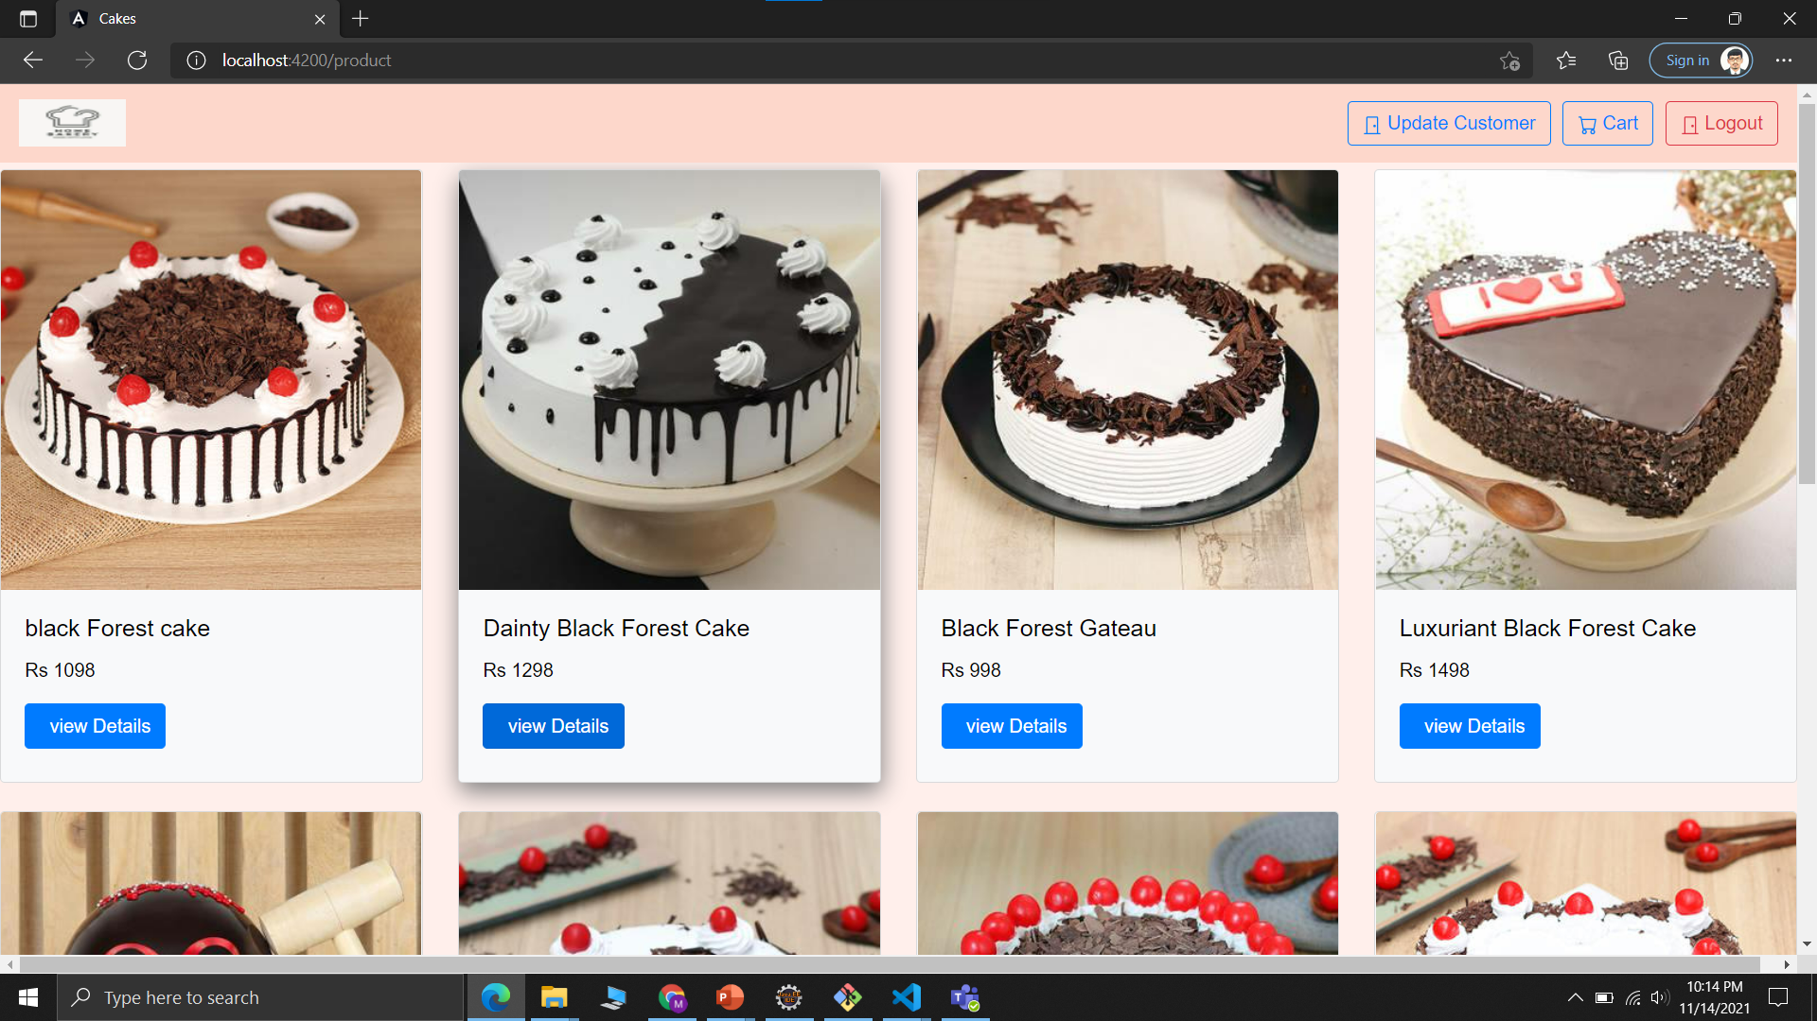
Product Page

Slide 11
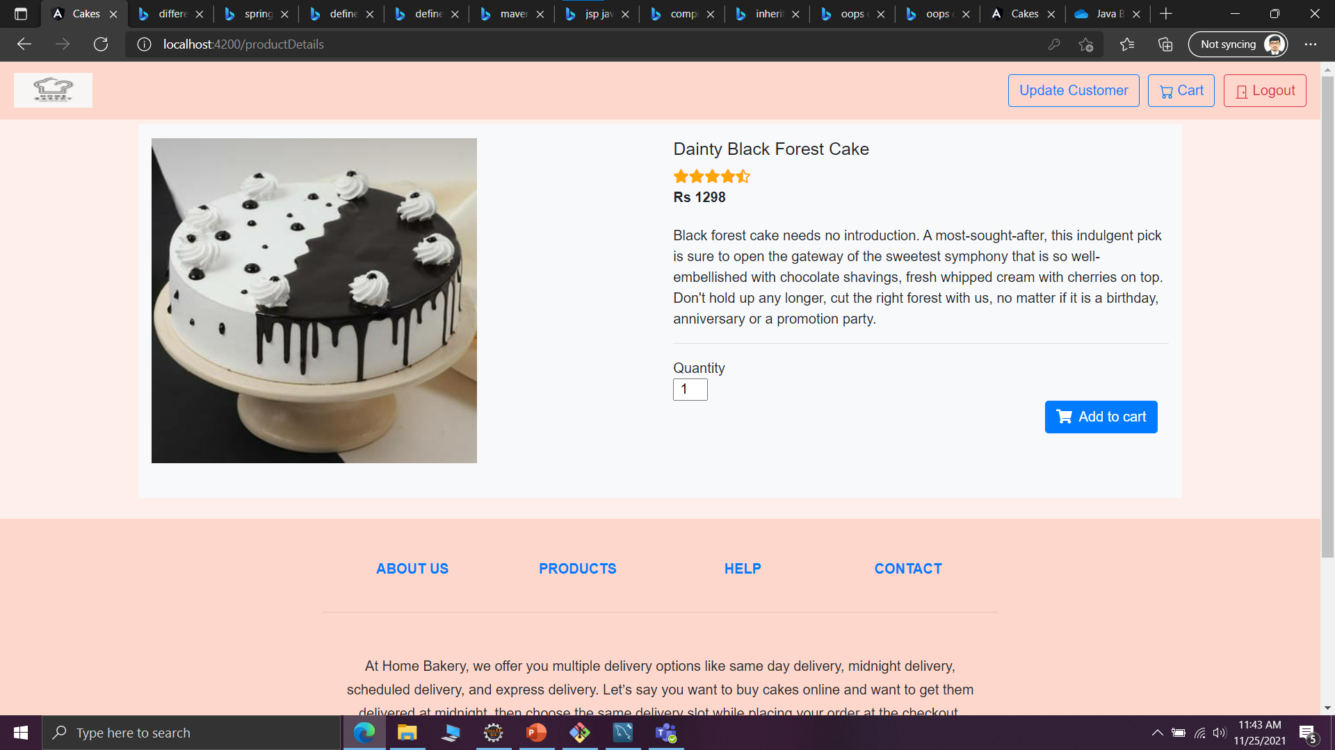
Product Details Page

Slide 12
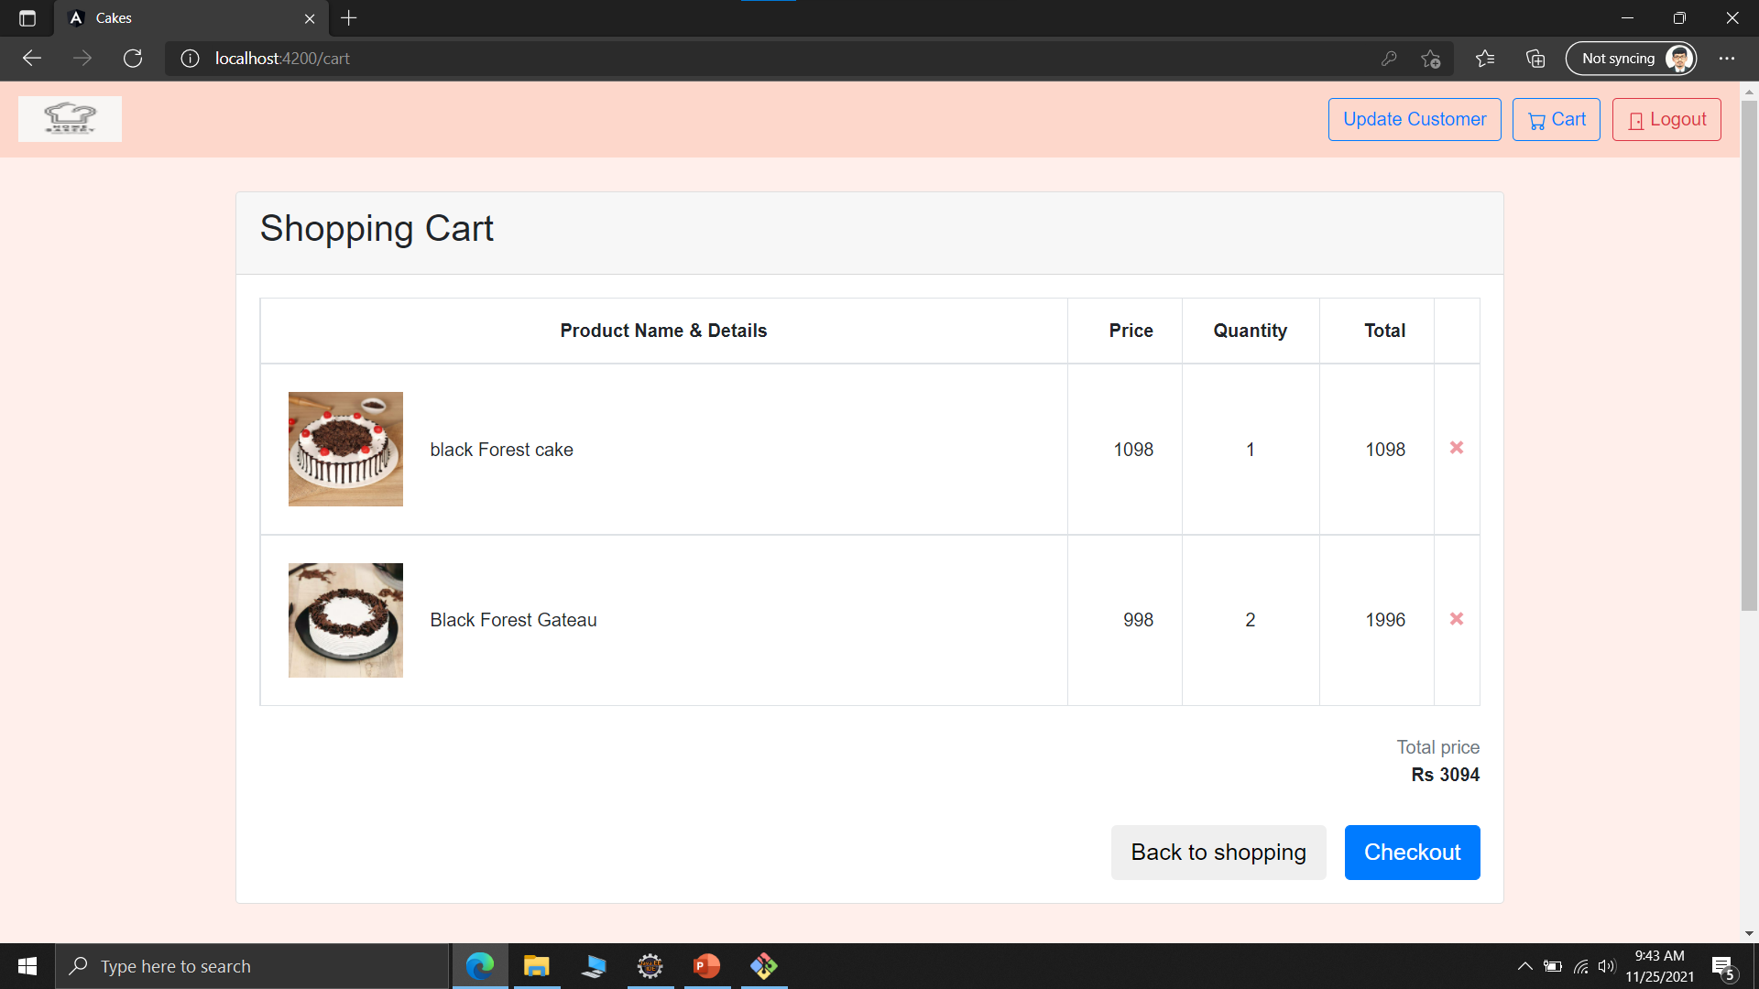
Cart Page

Slide 13
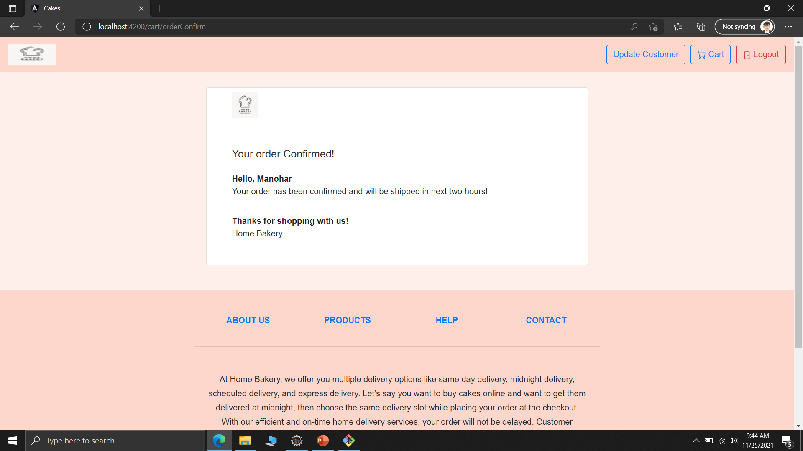
Order Confirm Page

Slide 14
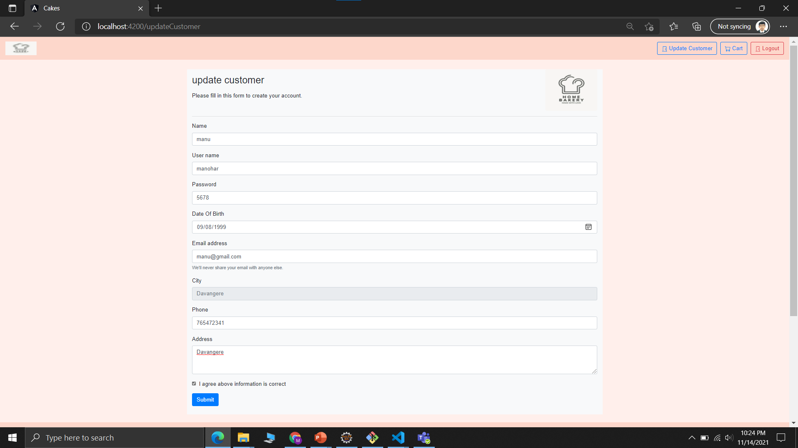
Update Customer Details

Slide 15
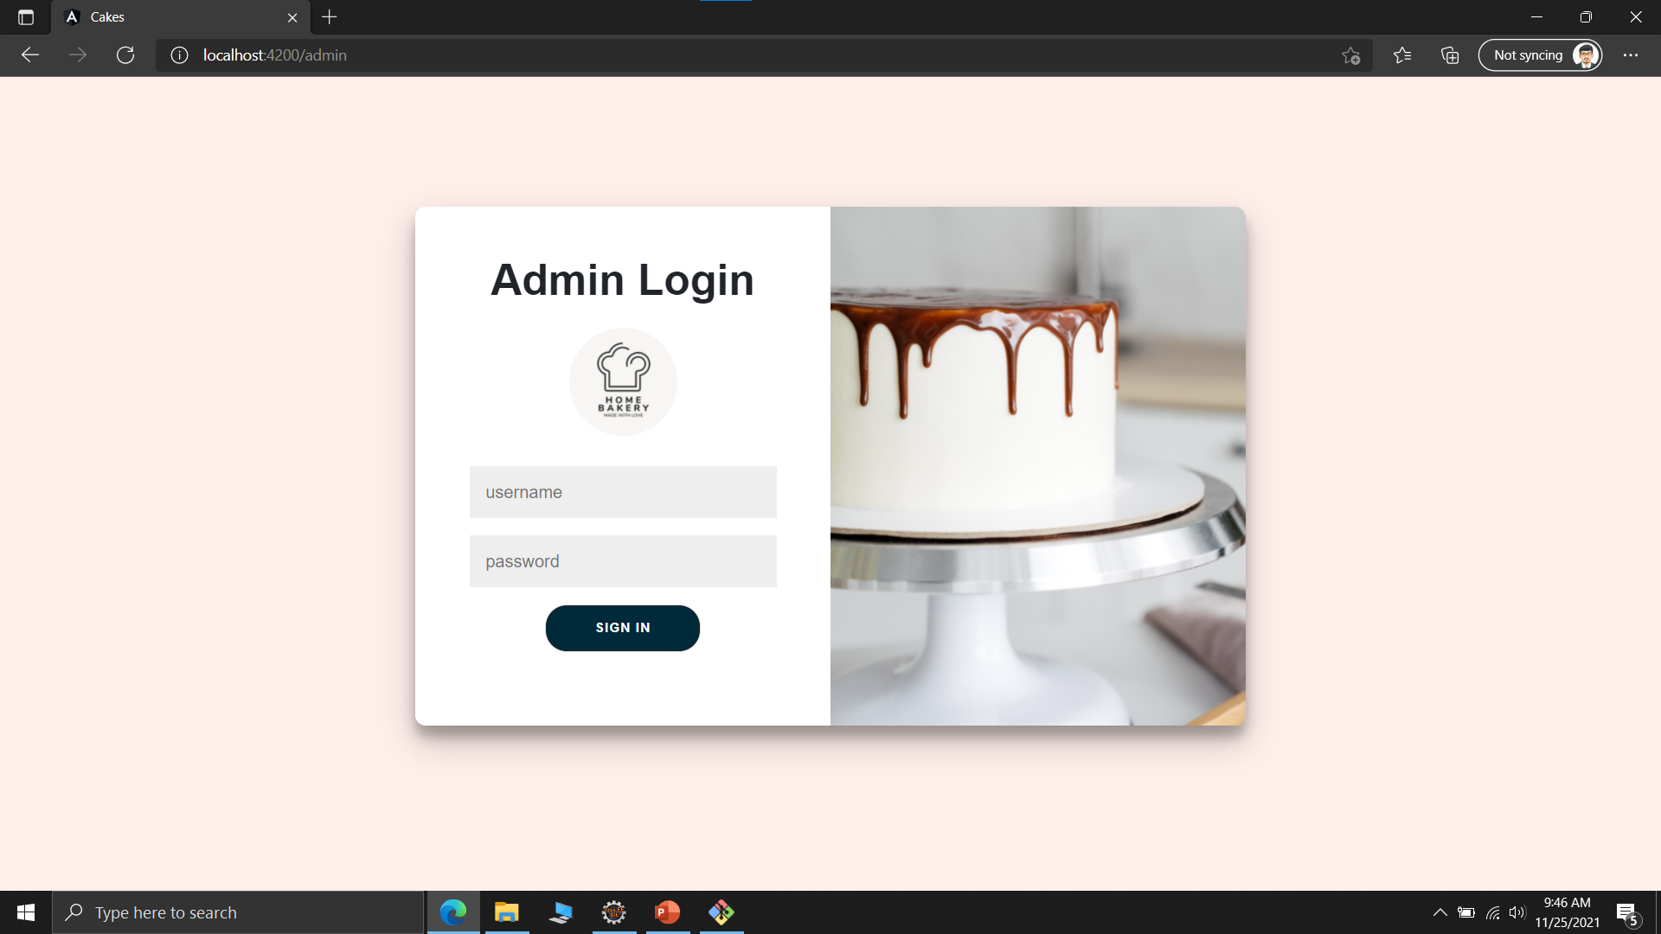
Admin Login Page

Slide 16
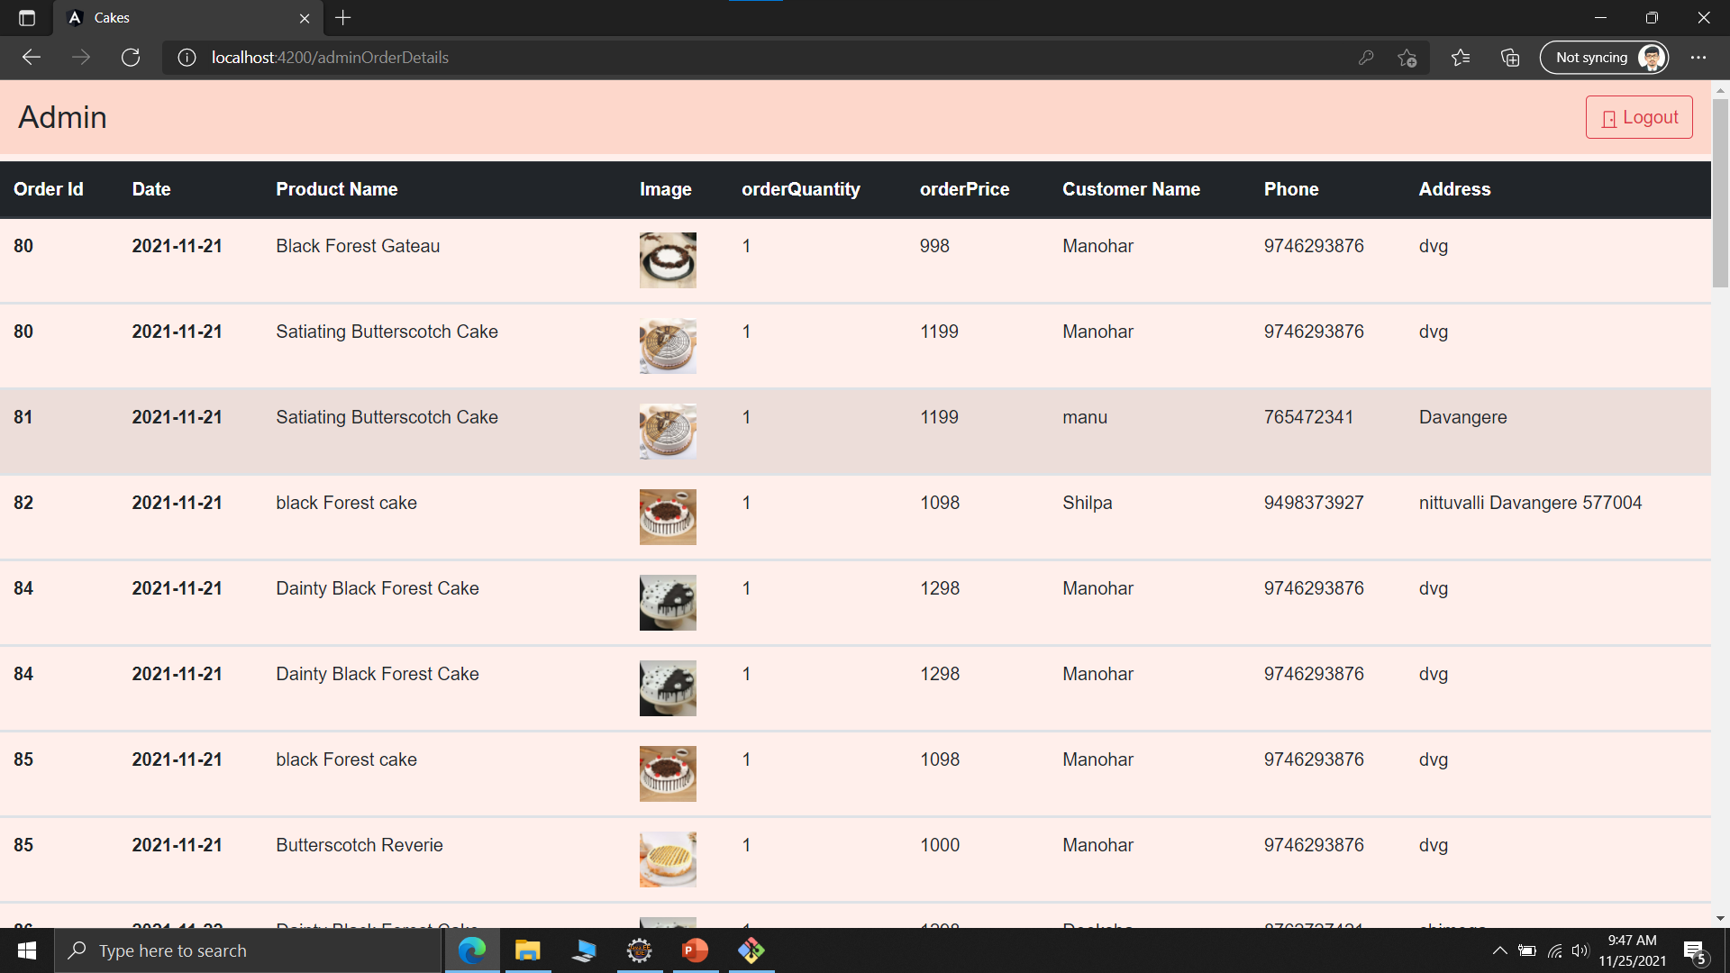
All Order Details

Slide 17
Take Away
Java
Angular
HTML ,CSS, JavaScript

Slide 18
Thank you

